Slide 1
Cinematic Techniques

Slide 2
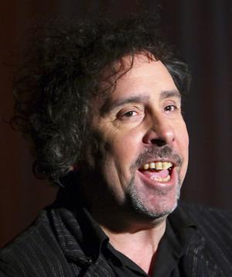
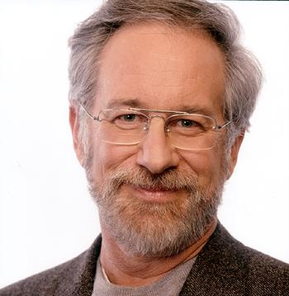
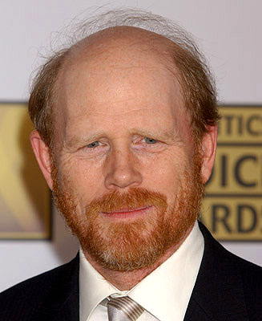
How movies are made
Cinematic techniques
the methods a director uses to communicate meaning and to evoke particular emotional responses in viewers.

Slide 3
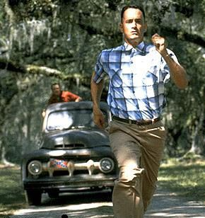
Shots and Framing
Shot: a single piece of film uninterrupted by cuts.

Slide 4
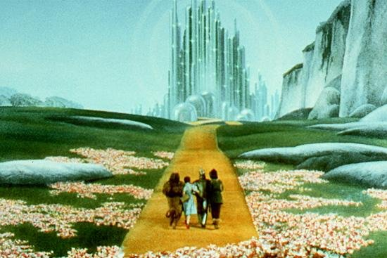
Shots and Framing
Establishing Shot: often a long shot or a series of shots that sets the scene. It is used to establish setting and to show transitions between locations.

Slide 5
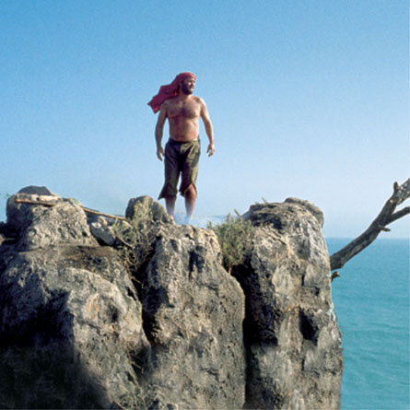
Shots and Framing
Long Shot (LS): a shot from some distance. If filming a person, the full body is shown. It may show the isolation or vulnerability of the character (also called a Full Shot).

Slide 6
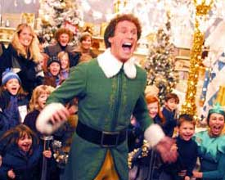
Shots and Framing
Medium Shot (MS): the most common shot. The camera seems to be a medium distance from the object being filmed. A medium shot shows the person from the waist up. The effect is to ground the story.

Slide 7
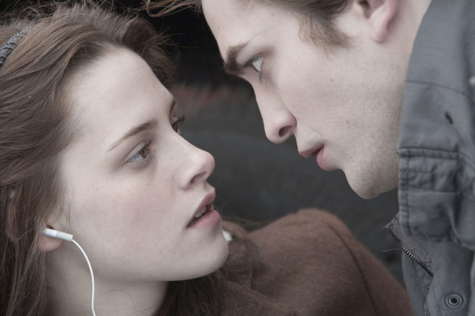
Shots and Framing
close Up (cU): the image takes up at least 80 percent of the frame.

Slide 8
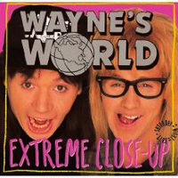
Shots and Framing
Extreme close Up: the image being shot is a part of a whole, such as an eye or a hand.

Slide 9
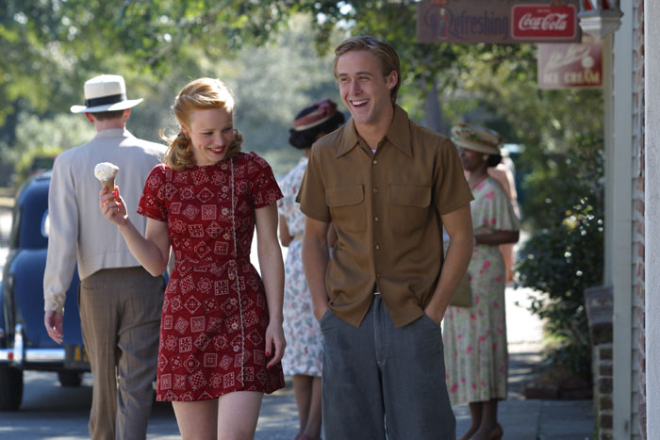
Shots and Framing
Two Shot: a scene between two people shot exclusively from an angle that includes both characters more or less equally. It is used in love scenes where interaction between the two characters is important.

Slide 10
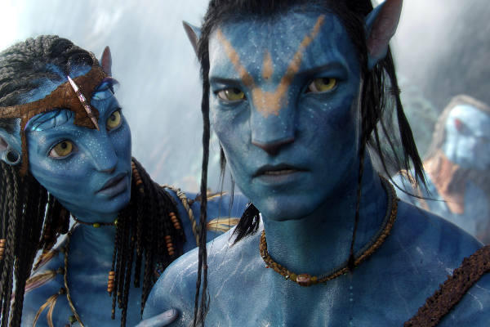
Camera Angles
Eye Level: a shot taken from a normal height; that is, the character’s eye level. Ninety to ninety-five percent of the shots seen are eye level, because it is the most natural angle.

Slide 11
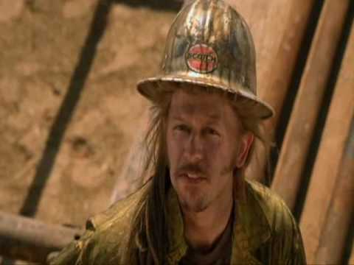
Camera Angles
High Angle: the camera is above the subject. This usually has the effect of making the subject look smaller than normal, giving him or her the appearance of being weak, powerless, and trapped.

Slide 12
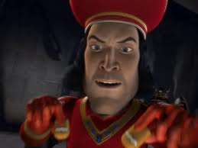
Camera Angles
Low Angle: the camera films subject from below. This usually has the effect of making the subject look larger than normal, and therefore strong, powerful, and threatening.

Slide 13
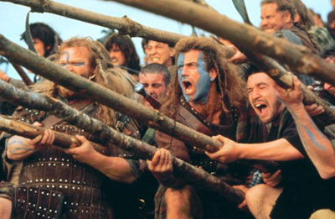
Camera Movements
Pan: a stationary camera moves from side to side on a horizontal axis.

Slide 14
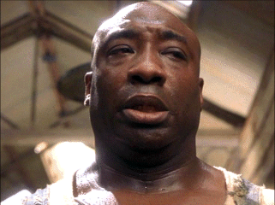
Camera Movements
tilt: a stationary camera moves up or down along a vertical axis.

Slide 15
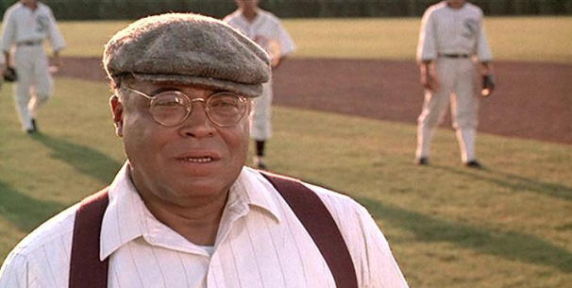
Camera Movements
Zoom: a stationary camera where the lens moves to make an object seem to move closer to or further away from the camera. With this technique, moving into a character is often a personal or revealing movement, while moving away distances or separates the audience from the character.

Slide 16
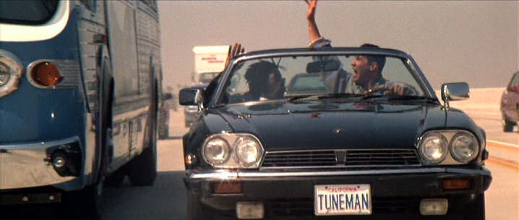
Camera Movements
Dolly/tracking: the camera is on a track that allows it to move with the action. The term also refers to any camera mounted on a car, truck, or helicopter.

Slide 17
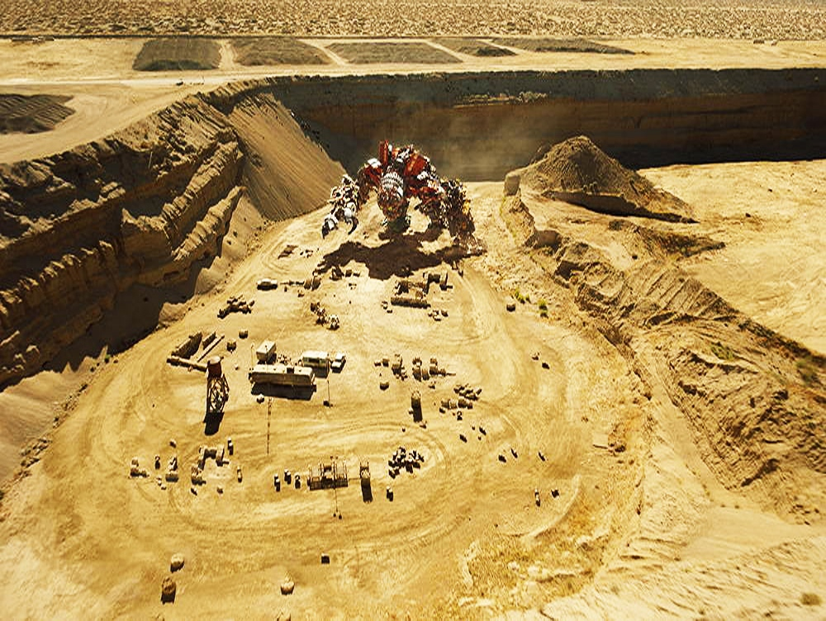
Camera Movements
Boom/crane: the camera is on a crane over the action. This is used to create overhead shots.

Slide 18
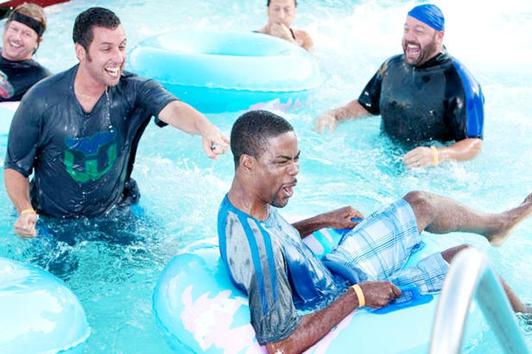
Lighting
High Key: the scene is flooded with light, creating a bright and open-looking scene.

Slide 19
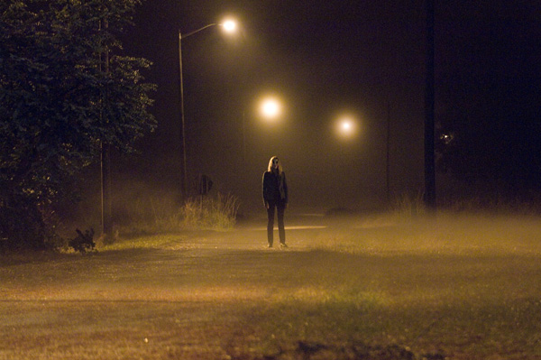
Lighting
Low Key: the scene is flooded with shadows and darkness, creating suspense or suspicion.

Slide 20
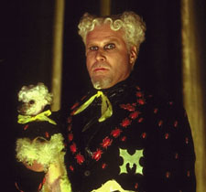
Lighting
Bottom or Side Lighting: direct lighting from below or the side, which often makes the subject appear dangerous or evil.

Slide 21
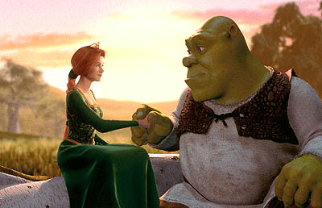
Lighting
Front or Back Lighting: soft lighting on the actor’s face or from behind gives the appearance of innocence or goodness, or a halo effect.

Slide 22
Editing Techniques
cut: most common editing technique. Two pieces of film are spliced together to “cut” to another image.
Example: Count the cuts

Slide 23
Editing Techniques
Fade: can be to or from black or white. A fade can begin in darkness and gradually assume full brightness (fade-in) or the image may gradually get darker (fade-out). A fade often implies that time has passed or may signify the end of a scene.

Slide 24
Editing Techniques
Dissolve: a kind of fade in which one image is slowly replaced by another. It can create a connection between images.

Slide 25
Editing Techniques
Wipe: a new image wipes off the previous image. A wipe is more fluid than a cut and quicker than a dissolve.

Slide 26
Editing Techniques
Flashback: cut or dissolve to action that happened in the past.
Example: Get into the way-back machine

Slide 27
Editing Techniques
Shot-Reverse-Shot: a shot of one subject, then another, then back to the first. It is often used for conversation or reaction shots.
Example: Follow the conversation

Slide 28
Editing Techniques
Cross cutting: cut into action that is happening simultaneously. This technique is also called parallel editing. It can create tension or suspense and can form a connection between scenes.
Eye-Line Match: cut to an object, then to a person. This technique shows what a person seems to be looking at and can reveal a character’s thoughts.

Slide 29
Sound
Diegetic: sound that could logically be heard by the characters in the film.
Example: Listen

Slide 30
Sound
Non-Diegetic: sound that cannot be heard by the characters but is designed for audience reaction only. An example might be ominous music for foreshadowing.
Example: Listen again

